Slide 1
Trauma and its impact on school
In order that we are better
prepared for challenging
situations at school

Slide 2
1. The psychological trauma a) What is a trauma b) Enlightenment versus brain imaging c) Cerebral cortex and amygdala d) Trauma in history e) Commonness of traumatised students f) Secure attachment g) Attempts to avoid a secure attachment in history h) acute psychological trauma i) Possible causes k) indication of a persistent psychological trauma l) Summary 2. Charged transferences a) Transferences are a normal phenomena b) Assuming positions of rescuer, victim, predator c) The concept of the good reason d) Safe place 3. Resilience a) Picture Book, Lily, Ben and Omid b) Brochure c) Your experiences
Notes:
_____________________________________________________________
_____________________________________________________________
_____________________________________________________________
_____________________________________________________________
_____________________________________________________________
_____________________________________________________________

Slide 3
1. The psychological Trauma

Slide 4
a) What is a trauma
“Trauma is … the result of an overwhelming amount of stress that exceeds one's ability to cope or integrate the emotions involved with that experience.”
SAMHSA. US Gov Homepage
Notes:
_____________________________________________________________
_____________________________________________________________
_____________________________________________________________
_____________________________________________________________
_____________________________________________________________
_____________________________________________________________

Slide 5
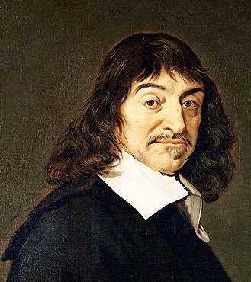
René Descartes 1596 - 1650, painting by Frans Hals
b) Enlightenment versus brain imaging
Since the age of Enlightenment 250 years ago, we
have had the idea that humanity acts in a
reasonable way, according to the following citation:
“Cogito, ergo sum.”
Notes:
_____________________________________________________________
_____________________________________________________________
_____________________________________________________________
_____________________________________________________________
_____________________________________________________________
_____________________________________________________________

Slide 6
Today, thanks to functional brain imaging and
neurobiological science, we know that most
behaviours are regulated by rationality, except in
experiences of profound threat. They lead to
behaviours which cannot be voluntarily
controlled. This is not caused by illness, rather it is a survival mechanism.
Notes:
_____________________________________________________________
_____________________________________________________________
_____________________________________________________________
_____________________________________________________________
_____________________________________________________________
_____________________________________________________________

Slide 7
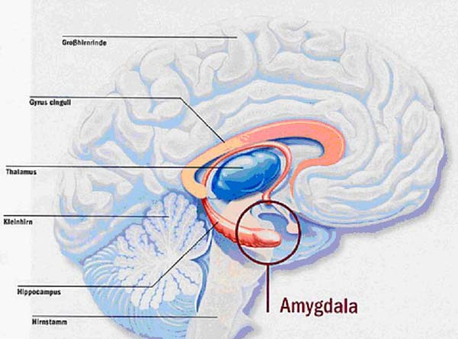
c) Cerebral cortex and amygdala
cerebral cortex amygdala
Quelle Bild: Kubrick, Blog at WordPress.com
Notes:
_____________________________________________________________
_____________________________________________________________
_____________________________________________________________
_____________________________________________________________
_____________________________________________________________
_____________________________________________________________

Slide 8
We know today that the limbic system, of which the
amygdala is part, can provoke neurobiological
reactions via the cerebral cortex, very quickly
without detour. There is no cerebral cortex control,
which could take too long and cause a deadly delay.
Endocrinal
effects
Amygdala
Notes:
_____________________________________________________________
_____________________________________________________________
_____________________________________________________________
_____________________________________________________________
_____________________________________________________________
_____________________________________________________________

Slide 9
The most recent research into neurobiological
effects has influenced expert opinion that a child
suffering from a post-traumatic stress disorder
cannot easily be trained to develop new skills which can be used in threatening situations. In such situations the cerebral cortex which has been trained, is de-activated.
Notes:
_____________________________________________________________
_____________________________________________________________
_____________________________________________________________
_____________________________________________________________
_____________________________________________________________
_____________________________________________________________

Slide 10
The dogma of the proposition of the Enlightenment:
„Cogito, ergo sum“ has today to be challenged,
particularly in our dealings with individuals with
psychological trauma.
Notes:
_____________________________________________________________
_____________________________________________________________
_____________________________________________________________
_____________________________________________________________
_____________________________________________________________
_____________________________________________________________

Slide 15
c)Trauma in history
“Post traumatic disorders” were known and described in recent centuries. That means that human beings knew about the vulnerability of the soul not only about that of the body. But it is interesting that it was a topic which was forgotten and tabooed when the threats were over.
It’s possible that we want to forget it because we feel that psychological trauma can be contagious.
See Jegodtka R. (2013): Berufsrisiko Sekundäre Traumatisierung? Carl-Auer-Systeme (Heidelberg)
Notes:
_____________________________________________________________
_____________________________________________________________
_____________________________________________________________
_____________________________________________________________
_____________________________________________________________
_____________________________________________________________

Slide 16
Example: World War I, Shellshock-Victims (War Neuroses)
Quelle: War Neuroses: Netley Hospital (1917) youtube
Notes:
_____________________________________________________________
_____________________________________________________________
_____________________________________________________________
_____________________________________________________________
_____________________________________________________________
_____________________________________________________________

Slide 17
d) Commonness of traumatised students
We deal with students with these problems in all phases of education, because intelligence is not linked to trauma and vice versa. We should acknowledge that in a standard class of 25 students, one or even more individuals are affected by trauma. In inclusive school systems this number is even higher.
Notes:
_____________________________________________________________
_____________________________________________________________
_____________________________________________________________
_____________________________________________________________
_____________________________________________________________
_____________________________________________________________

Slide 18
Children and young people who have very exceptional and disturbing behaviour could be suffering from psychological trauma.
Notes:
_____________________________________________________________
_____________________________________________________________
_____________________________________________________________
_____________________________________________________________
_____________________________________________________________
_____________________________________________________________

Slide 19
e) Secure attachment
A secure attachment is the most important factor which insulates a human being from psychological trauma. When we have dealings with children and young people who show signs of a trauma disorder, there is often a history of insecure attachment (avoidant and ambivalent attachment or disorganised attachment classification). An otherwise secure attachment style could have given the child protection .
Notes:
_____________________________________________________________
_____________________________________________________________
_____________________________________________________________
_____________________________________________________________
_____________________________________________________________
_____________________________________________________________

Slide 20
A secure attachment can only be developed with
a person who gives appropriate and sensitive
response. Sensitiveness means that the adult
responds with a fast and appropriate response
to the child’s needs and actions.

Slide 21
f) Attempts to avoid a secure attachment in history

Slide 22
Dictatorship tries to avoid a secure attachment; people need more security from the government and more easily accept the rigidity of totalitarism
The modern economy could be interested in customers with no secure attachment; they consume more (???)

Slide 23
h) acute psychological trauma
Poor memory
Avoidance
Alertness
Difficulties to concentrate
Flashbacks unexpected
These are normal reactions of an insane situation and should fade after some time, but when the trauma gets chronical they can persist
Notes:
_____________________________________________________________
_____________________________________________________________
_____________________________________________________________
_____________________________________________________________
_____________________________________________________________
_____________________________________________________________

Slide 24
i) Possible causes
As professionals working with children and
young people, we are confronted with both
current and recent psychological trauma. Many
of them are clear:
Illness and death in the family
Accident
Natural disaster
Divorce, separation, loss
War
Loss of parental employment

Slide 25
There are other factors which can impact on a
child’s mental health, but these are often
societal taboos:
Neglect
Bullying (School is involved)
Sexual abuse
Violence (especially in their own family)

Slide 26
Traumatic experience caused by bullying, a frequent issue in educational organisations, is often directly linked to the school environment. Bullying should not be underestimated as a cause of trauma.
Notes:
_____________________________________________________________
_____________________________________________________________
_____________________________________________________________
_____________________________________________________________
_____________________________________________________________
_____________________________________________________________

Slide 27
f) Causes for psychological trauma (summary) acute trauma persistent trauma
Neclect in early childhood
Illness and death in the family
Accident
Natural disaster
Divorce, separation, loss
War
Loss of parental employment
Neglect
Bullying
Sexual abuse
Violence (especially in their own
family)
Illness and death in the family
Accident
Natural disaster
Divorce, separation, loss
War
Loss of parental employment
Neglect
Bullying
Sexual abuse
Violence (especially in their own
family)
Notes:
_____________________________________________________________
_____________________________________________________________
_____________________________________________________________
_____________________________________________________________
_____________________________________________________________
_____________________________________________________________

Slide 28
k) indication of a persistent psychological trauma Some examples
Notes:
_____________________________________________________________
_____________________________________________________________
_____________________________________________________________
_____________________________________________________________
_____________________________________________________________
_____________________________________________________________

Slide 29
Clothes not appropriate for temperature
Notes:
_____________________________________________________________
_____________________________________________________________
_____________________________________________________________
_____________________________________________________________
_____________________________________________________________
_____________________________________________________________

Slide 30
Age-inappropriate behaviour
Notes:
_____________________________________________________________
_____________________________________________________________
_____________________________________________________________
_____________________________________________________________
_____________________________________________________________
_____________________________________________________________

Slide 31
Strange behaviour
Notes:
_____________________________________________________________
_____________________________________________________________
_____________________________________________________________
_____________________________________________________________
_____________________________________________________________
_____________________________________________________________

Slide 32
Notes:
_____________________________________________________________
_____________________________________________________________
_____________________________________________________________
_____________________________________________________________
_____________________________________________________________
_____________________________________________________________

Slide 33
Violence against oneself
Notes:
_____________________________________________________________
_____________________________________________________________
_____________________________________________________________
_____________________________________________________________
_____________________________________________________________
_____________________________________________________________

Slide 34
Poor memory
Notes:
_____________________________________________________________
_____________________________________________________________
_____________________________________________________________
_____________________________________________________________
_____________________________________________________________
_____________________________________________________________

Slide 35
Assume positions of adults
Notes:
_____________________________________________________________
_____________________________________________________________
_____________________________________________________________
_____________________________________________________________
_____________________________________________________________
_____________________________________________________________

Slide 36
Lost in space and time
Notes:
_____________________________________________________________
_____________________________________________________________
_____________________________________________________________
_____________________________________________________________
_____________________________________________________________
_____________________________________________________________

Slide 37
That has an impact on maths and geometry
Notes:
_____________________________________________________________
_____________________________________________________________
_____________________________________________________________
_____________________________________________________________
_____________________________________________________________
_____________________________________________________________

Slide 38
Freeze

Slide 39
l) Summary
Traumatised children confront us as teachers, therapists or social workers with their trauma – whether we like it or not !
Children with psychological trauma re-enact their stories in their daily life, including school.
They transfer their experience of traumatic attachment.
Notes:
_____________________________________________________________
_____________________________________________________________
_____________________________________________________________
_____________________________________________________________
_____________________________________________________________
_____________________________________________________________

Slide 40
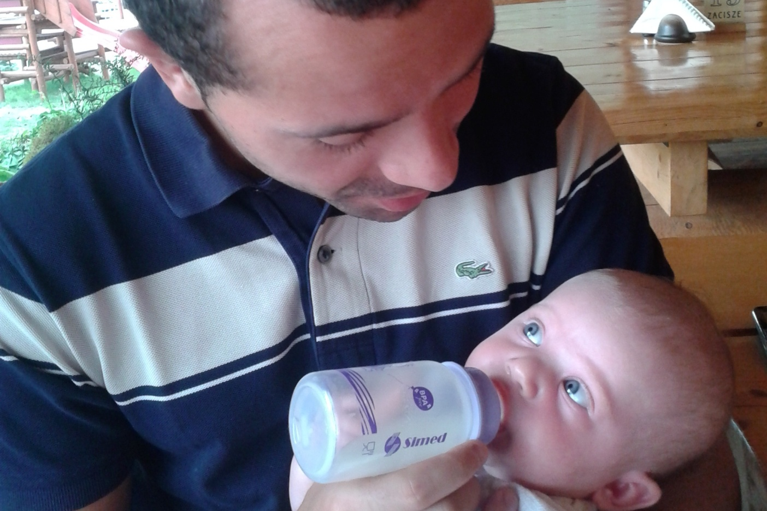
2. Charged transferences
Notes:
_____________________________________________________________
_____________________________________________________________
_____________________________________________________________
_____________________________________________________________
_____________________________________________________________
_____________________________________________________________

Slide 41
a) Transferences are normal phenomena They exist everywhere when human beings are in contact. It’s helpful to consider them as relevant

Slide 42
To avoid transferences, don’t sit face to face, shoulder to shoulder

Slide 43
Walking reduces transferences and helps to find good solutions

Slide 44
A person with a chronified trauma disorder will be triggered and this leads to actions he cannot control. These actions can be understood as self-healing attempts of the soul hoping that this time the action leads to a happy end and the problem can be solved and abandoned. At the same time the action unconsciously leads to a failure; this fact provokes a retraumatisation which strenghtens the trauma disorder.
Notes:
_____________________________________________________________
_____________________________________________________________
_____________________________________________________________
_____________________________________________________________
_____________________________________________________________
_____________________________________________________________

Slide 45
It is like a red carpet which is the invitation for us to step on it and to act up in the play of the trauma
Notes:
_____________________________________________________________
_____________________________________________________________
_____________________________________________________________
_____________________________________________________________
_____________________________________________________________
_____________________________________________________________

Slide 47
But if we don’t step on this red carpet and stay in our “self”, we make new outcomes possible. The trauma pedagogy can help to identify how to find a good way to escape of the “trauma play”. A very simple and powerful method is the “concept of the good reason”.
Notes:
_____________________________________________________________
_____________________________________________________________
_____________________________________________________________
_____________________________________________________________
_____________________________________________________________
_____________________________________________________________

Slide 49
b) Assuming positions of rescuer, victim, persecutor
Typically, we have strong feelings in our dealings with heavily traumatised children and young people. These feelings can be transferred. If we don’t recognise them as transferences, we risk illness through prolonged exposure. Supervision helps to identify and understand this dynamic, and to benefit from improved knowledge of the student and his problems. Only if transferences are recognised can a stable relationship be developed. Very often transferences are mixed up with the own feeling of the professional. They can be linked to the own biography; we feel attracted to a special position, to a rescuer, to a victim or to a persecutor.
Notes:
_____________________________________________________________
_____________________________________________________________
_____________________________________________________________
_____________________________________________________________
_____________________________________________________________
_____________________________________________________________

Slide 50
With transferences we risk assuming the position of the rescuer, the persecutor or the victim. Only reflective practitioners can help others while retaining their own morale.
Notes:
_____________________________________________________________
_____________________________________________________________
_____________________________________________________________
_____________________________________________________________
_____________________________________________________________
_____________________________________________________________

Slide 51
It is important to come back to the position to “Myself”. There I have connection to my skills and knowledge.

Slide 53
Transferential dynamics are powerful traps. As professionals interacting with impacted students it’s important to identify these dynamics to stay in a good mental health.
Notes:
_____________________________________________________________
_____________________________________________________________
_____________________________________________________________
_____________________________________________________________
_____________________________________________________________
_____________________________________________________________

Slide 54
c) The concept of the good reason
For the interaction with traumatised students the “concept of the good reason” is very helpful. We admit that the student has a good reason for his behaviour even if this behaviour is difficult and/or inacceptable for us as teachers or social workers:
“You might have a good reason that you…”
(Alice Ebel)
Notes:
_____________________________________________________________
_____________________________________________________________
_____________________________________________________________
_____________________________________________________________
_____________________________________________________________
_____________________________________________________________

Slide 56
d) A „safe place“ „A safe place“ only makes possible that the very efficient strategies to survive will be given up and alternative behaviours can be installed.“ Marc Schmid 2012
Notes:
_____________________________________________________________
_____________________________________________________________
_____________________________________________________________
_____________________________________________________________
_____________________________________________________________
_____________________________________________________________

Slide 57
Notes:
_____________________________________________________________
_____________________________________________________________
_____________________________________________________________
_____________________________________________________________
_____________________________________________________________
_____________________________________________________________

Slide 58
3. Resilience
Empowering students doing projects like YESTERMORROW
Dedicated work of all partners
…..

Slide 59
Walking to get in contact with each other

Slide 60
Visualization

Slide 61
Transparency

Slide 62
Individual solutions

Slide 63
Living effectiveness

Slide 65
Minimizing the danger of Bullying

Slide 66
Positive approach

Slide 67
„If children live with encouragement, they learn confidence“

Slide 68
Intellectual outputs

Slide 69
Picture book

Slide 70
Which languages?
How many copies?
Who does the translations?
Schedule?

Slide 71
A similar book for older students???

Slide 72
Brochure
Languages?
How many copies?
Translations?
Schedule?

